Slide 1
Replica Management

Slide 2
Replica Management
Replica-Server placement :-decide the best location to place the replica server that can host data store
Content Replication & Placement:- Finds the best server for placing the contents

Slide 3
Replica-Server placement
It basically state about where the server should be placed and how many no.of replicas are to be created .
To identify location
Caalculate the distance b/w u r assumed server and calculate average and decide best place

Slide 4
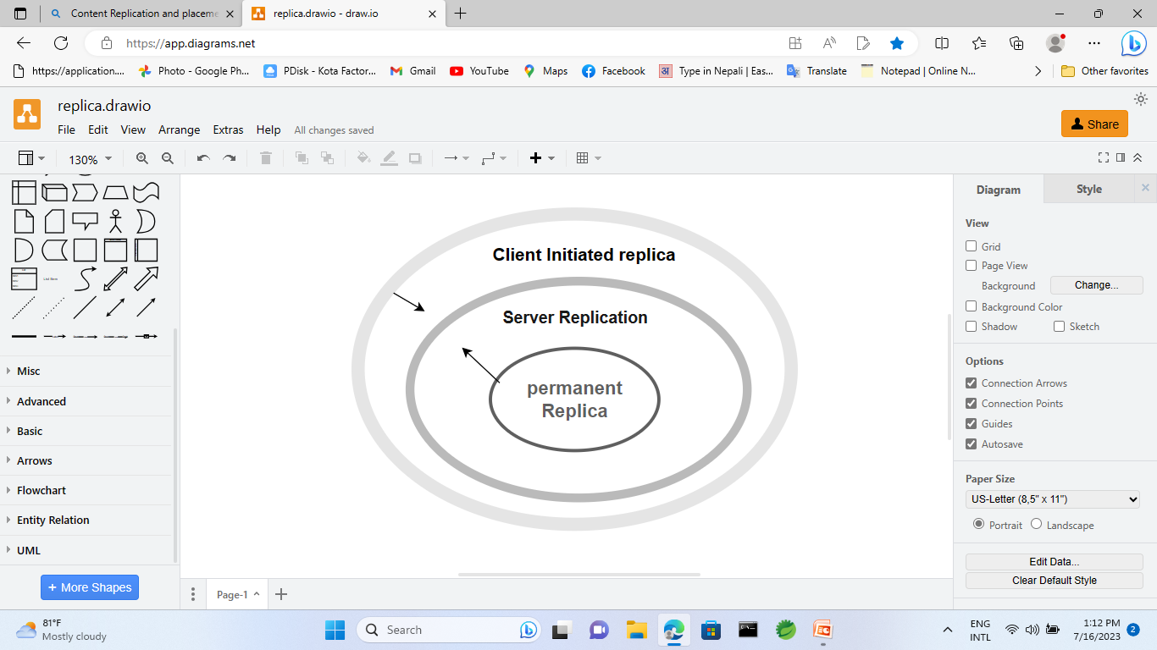
Content Replication and placement
Permanent Replica =original server
Server-Initiated replica=Hosting extra server replica on to the diff server
Client Initiated replica=it is request of a client
Or (client cache)

Slide 5
Content Replication and placement
Type:-
Server initiated replica
Client-initiated replica

Slide 6
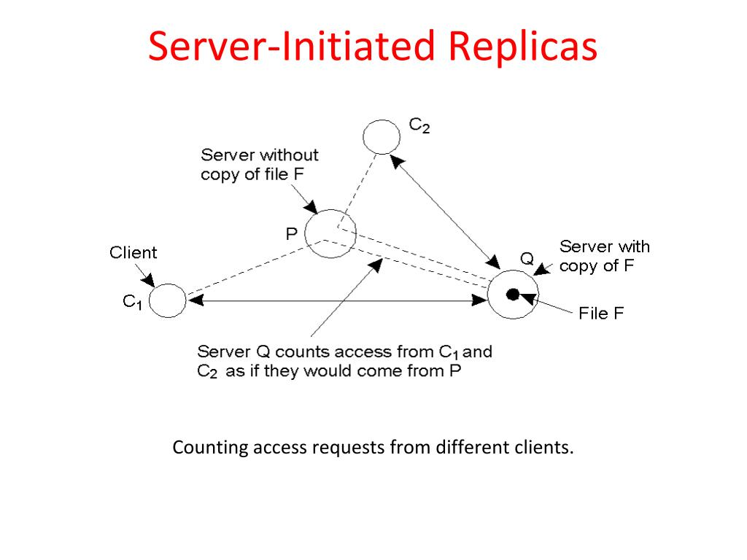

Slide 7
Client-initiated replica
Also called a caches(works like cache memory)
At client side there is a volatile memory
The data which is frequently used that is stored in the memory, Next time when user req for a data ----→it would easy/fast..

